Slide 1


VISVESVARAYA TECHNOLOGICAL UNIVERSITY JNANA SANGAMA, BELAGAVI
Bheemanna Khandre Institute Of Technology, Bhalki.
Bachelor Of Engineering.
Department Of CSE (Artificial Intelligence And Machine Learning)
“AUTOMATION OF VEHICLE RESERVATION SYSTEM”
BY :
Abhijeet Jadhav (3RB21AI001)
Akshay Hulsure (3RB21AI004)
Amanullah (3RB21AI005)
Ambika (3RB21AI006)
Under the Guidance of
Prof.Vijeta.D
Dept. of CSE(AI & ML)

Slide 2
CONTENTS:
Introduction
Objectives
System analysis
Modules
Requirements
System design
System testing and implementation
Code efficiency
Advantages
Disadvantages
Output
Conclusion

Slide 3
INTRODUCTION:
Aim to develop an online bike reservation system where online reservation of the bike service can be done.
The system provides an easy way of providing the reservation of bikes.
Here if you want to buy the bike from some showroom, then you can easily reserve the bike online without going to the showroom.

Slide 4
OBJECTIVE:
Develop an online application with highest security.
The application has to be multiuser one.
The application should be able handle the queries of the customer in real time.
The service has to be 24 X 7.

Slide 5
SYSTEM ANALYSIS:
System analysis
System Design
Existing System
Proposed System

Slide 6
MODULES:
Vehicle
Customers
Booking
Branches
Service

Slide 7
REQUIREMENTS:
Software requirements:
Operating System : Windows XP
Technology : Java 1.6
Web Technologies : Html, JavaScript
Web Server : Tomcat 5.5
Database : Mysql
Hardware requirements:
Processor : Pentium Dual core 1.6
Hard Disk : 160GB
RAM : 512MB

Slide 8
SYSTEM DESIGN:
System Design is the next development stage where the overall architecture of the desired system is decided.
The system is organized as a set of sub systems interacting with each other.
While designing the system as a set of interacting subsystems, the analyst takes care of specifications as observed in system analysis as well as what is required out of the new system by the end user.

Slide 9
SYSTEM TESTING AND IMPLEMENTATION
UNIT TESTING
INTEGRATION TESTING
VALIDATION TESTING
MAINTENANCE
SOFTWARE TESTING
WHITE BOX TESTING
SPECIFICATION-BASED TESTING

Slide 10
CODE EFFICIENCY
The code is designed with the following characteristics
Uniqueness
Expandability
Conciseness
Uniform size and format
Simplicity
Versatility
Storability
Stability
Meaningfulness

Slide 11
ADVANTAGES:
24 X 7 availability of services.
Information is secured.
Multiple users can use the application without any limitation of the location.
Since the application is placed on the server the data is distributed.

Slide 12
DISADVANATGES:
Requires computer and internet knowledge.
If server is down then the application cannot be used.
Fast internet connectivity is required.

Slide 13
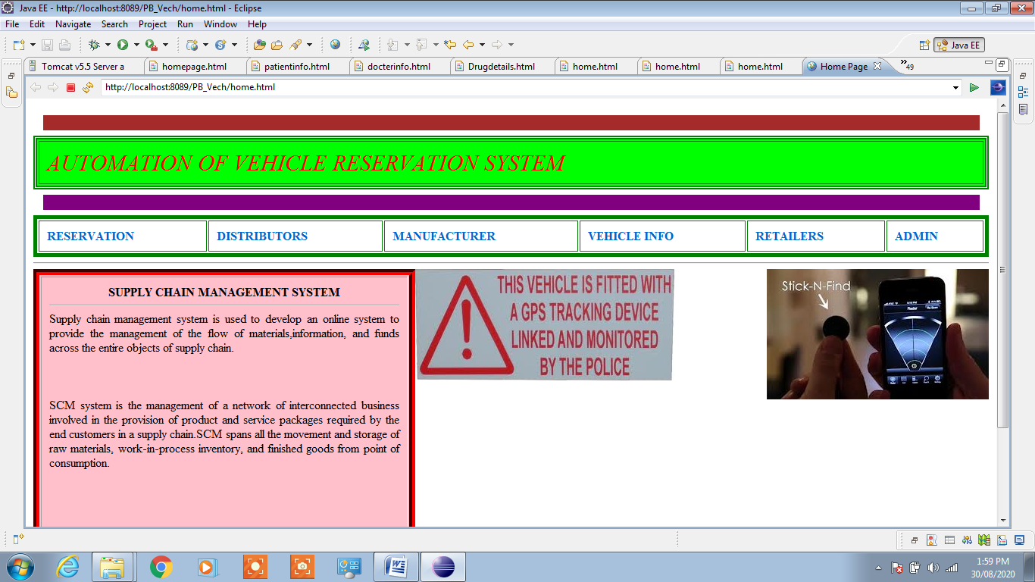
OUTPUTS:

Slide 14
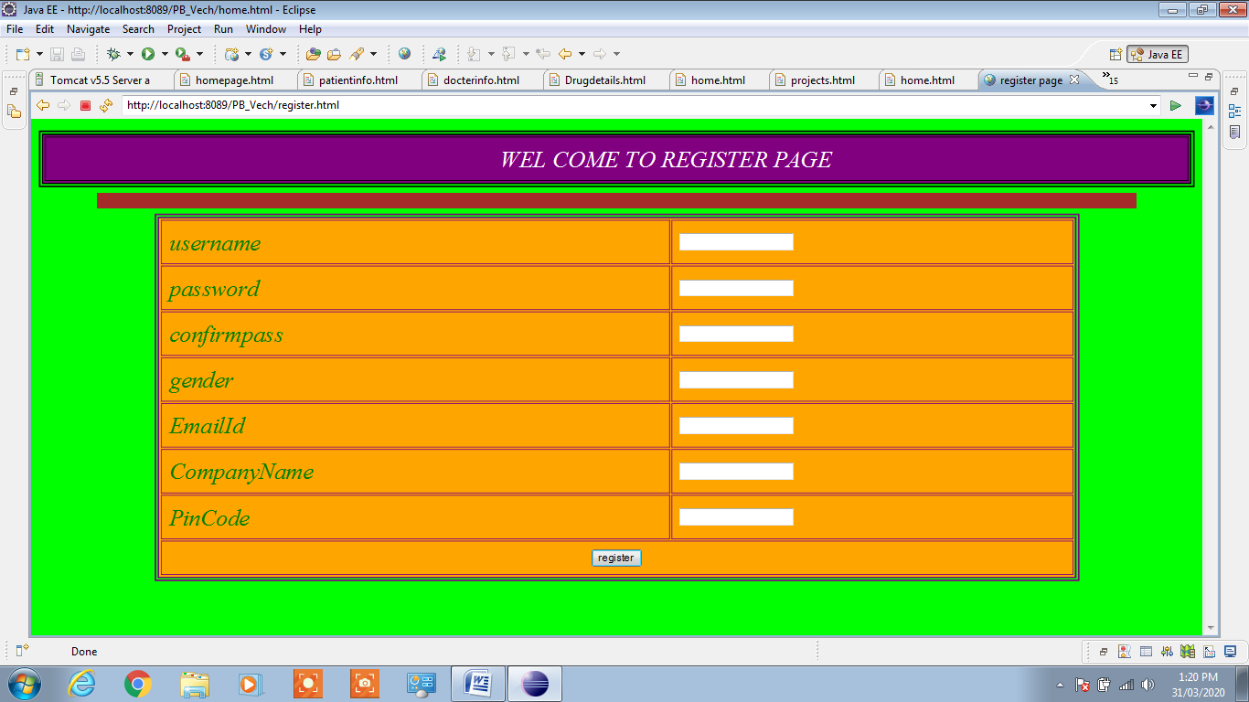

Slide 15
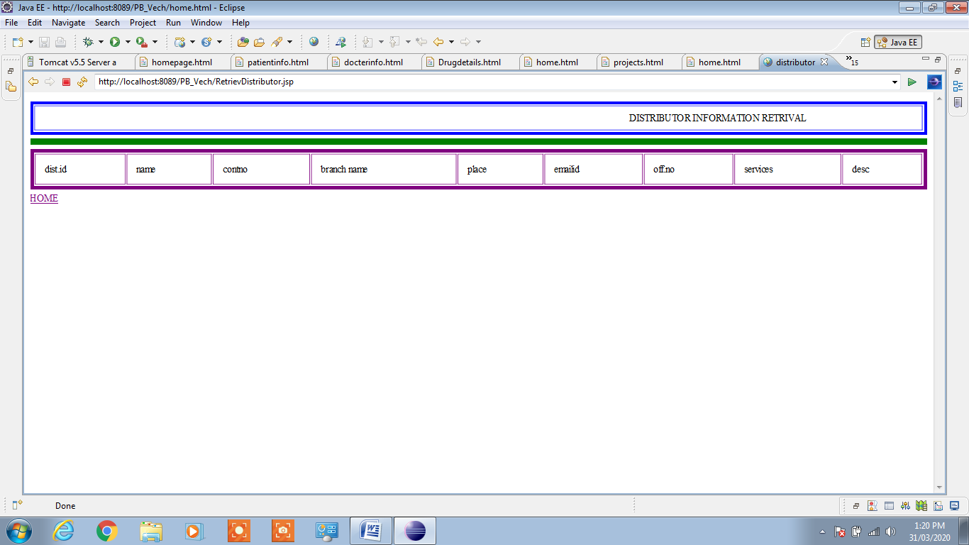

Slide 16
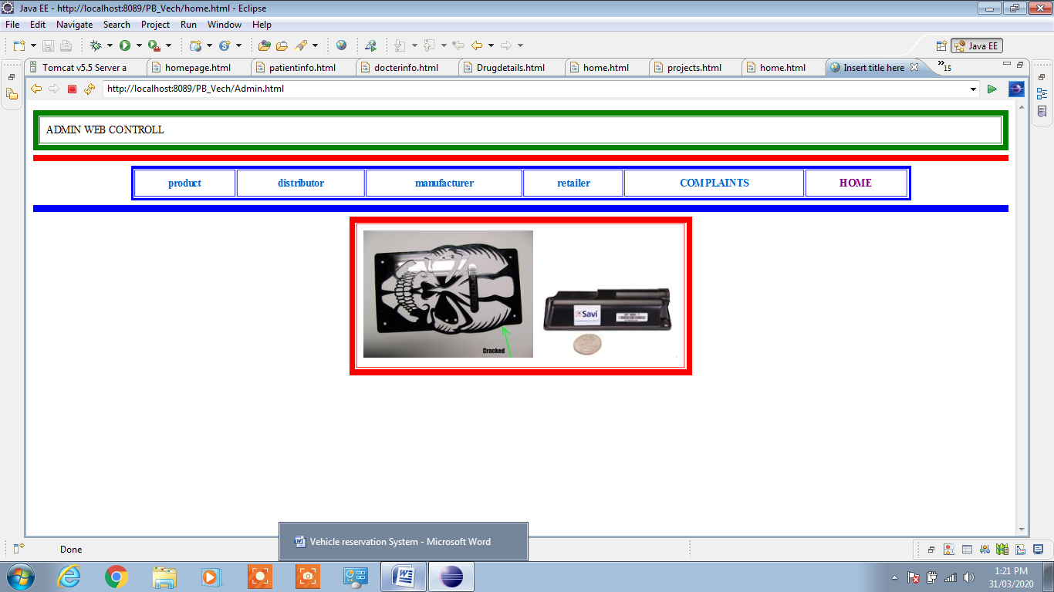

Slide 17
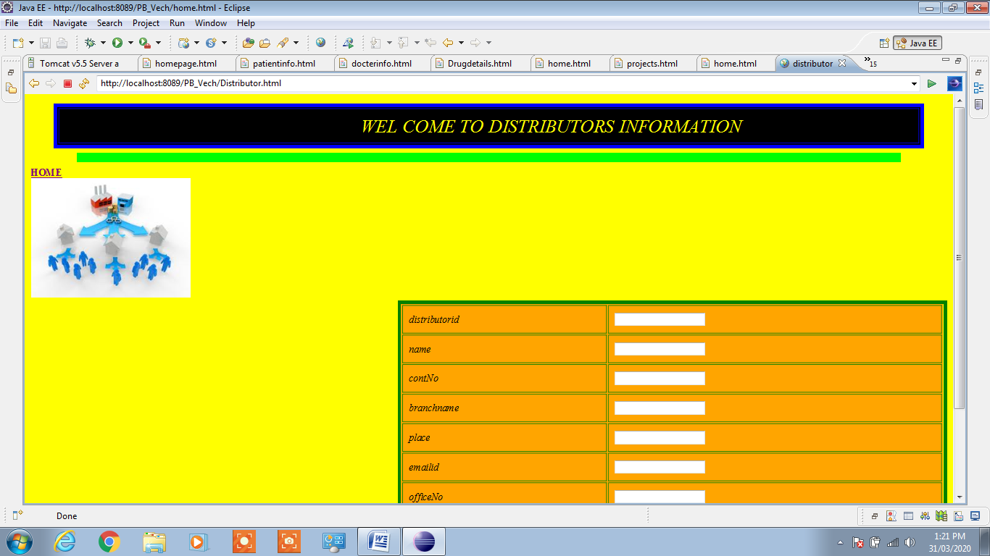

Slide 18
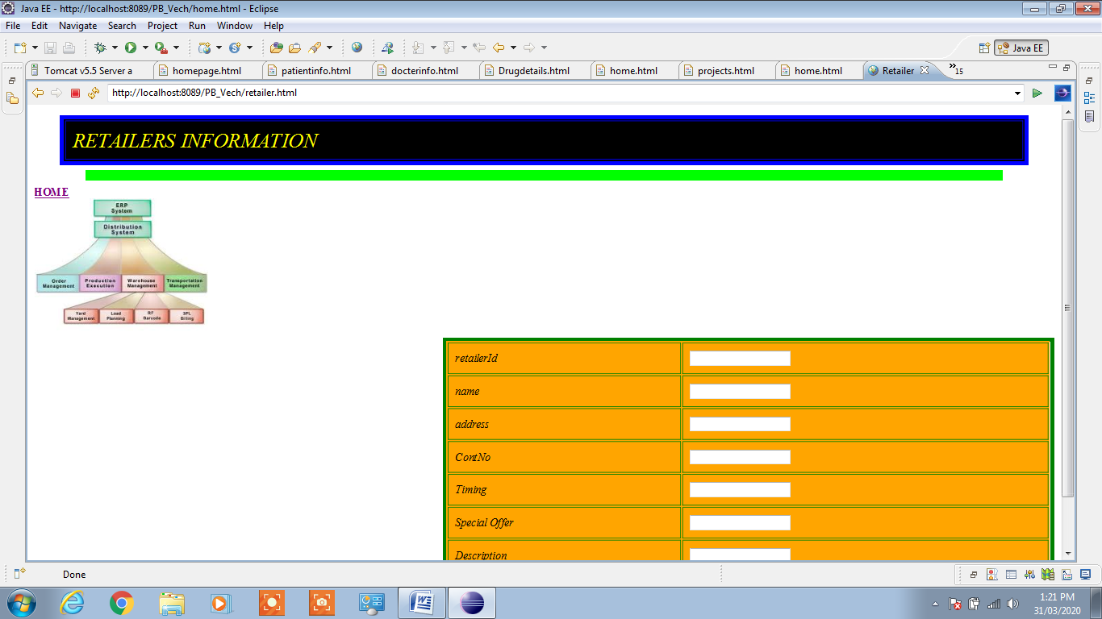

Slide 19
CONCLUSION
The system provides an easy way of providing the reservation of bikes. Here if you want to buy the bike from some show room, then you can easily reserve the bike online without going to the show room.
A computer reservations system (CRS) is a computerized system used to store and retrieve information and conduct transactions related to air travel.

Slide 20


